Slide 1
PROJECTILE MOTION
Senior High School Physics
Lech Jedral
2006
Part 1.
Part 2.
Free powerpoints at http://www.worldofteaching.com

Slide 2
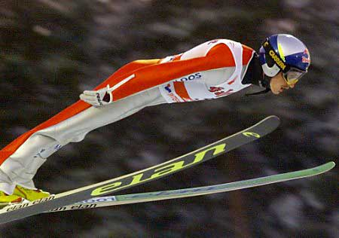


Introduction
Projectile Motion:
Motion through the air without a propulsion
Examples:

Slide 3
Part 1.
Motion of Objects Projected Horizontally

Slide 4
y
v₀
x

Slide 5
y
x

Slide 6
y
x

Slide 7
y
x

Slide 8
y
x

Slide 9
y
Motion is accelerated
Acceleration is constant, and downward
a = g = -9.81m/s²
The horizontal (x) component of velocity is constant
The horizontal and vertical motions are independent of each other, but they have a common time
g = -9.81m/s²
x

Slide 10
ANALYSIS OF MOTION
ASSUMPTIONS:
x-direction (horizontal): uniform motion
y-direction (vertical): accelerated motion
no air resistance
QUESTIONS:
What is the trajectory?
What is the total time of the motion?
What is the horizontal range?
What is the final velocity?

Slide 11
Frame of reference:
Equations of motion:
y
 | X Uniform m. | Y Accel. m.
ACCL. | a_{x} = 0 | a_{y} = g = -9.81 m/s²
VELC. | v_{x} = v₀ | v_{y} = g t
DSPL. | x = v₀ t | y = h + ½ g t²
v₀
h
g
x
0

Slide 12
Trajectory
x = v₀ t
y
y = h + ½ g t²
Parabola, open down
h
Eliminate time, t
t = x/v₀
y = h + ½ g (x/v₀)²
y = h + ½ (g/v₀²) x²
y = ½ (g/v₀²) x² + h
v₀₁
v₀₂ > v₀₁
x

Slide 13
Total Time, Δt
Δt = t_{f} - t_{i}
y = h + ½ g t²
final y = 0
y
0 = h + ½ g (Δt)²
t_{i} =0
h
Solve for Δt:
Δt = √ 2h/(-g)
Δt = √ 2h/(9.81ms⁻²)
t_{f} =Δt
Total time of motion depends only on the initial height, h
x

Slide 14
Horizontal Range, Δx
x = v₀ t
y
final y = 0, time is the total time Δt
Δx = v₀ Δt
h
Δt = √ 2h/(-g)
Δx = v₀ √ 2h/(-g)
Δx
Horizontal range depends on the initial height, h, and the initial velocity, v₀
x

Slide 15
VELOCITY
v_{x} = v₀
^{Θ}
v_{y} = g t
v
v = √v_{x}² + v_{y}²
= √v₀²+g²t²
^{tg Θ = v}_{y}^{/ v}_{x} ^{= g t / v}₀

Slide 16
FINAL VELOCITY
v_{x} = v₀
Δt = √ 2h/(-g)
tg Θ = g Δt / v₀
= -(-g)√2h/(-g) / v₀
= -√2h(-g) / v₀
^{Θ}
v_{y} = g t
v
v = √v_{x}² + v_{y}²
v = √v₀²+g²(2h /(-g))
v = √ v₀²+ 2h(-g)
Θ is negative (below the horizontal line)

Slide 17
HORIZONTAL THROW - Summary
h – initial height, v₀ – initial horizontal velocity, g = -9.81m/s²
Trajectory | Half -parabola, open down
Total time | Δt = √ 2h/(-g)
Horizontal Range | Δx = v₀ √ 2h/(-g)
Final Velocity | v = √ v₀²+ 2h(-g) tg Θ = -√2h(-g) / v₀

Slide 18
Part 2.
Motion of objects projected at an angle

Slide 19
y
v_{i}
Initial position: x = 0, y = 0
Initial velocity: vi = v_{i} [Θ]
Velocity components:
x- direction : v_{ix} = v_{i} cos Θ
y- direction : v_{iy} = v_{i} sin Θ
v_{iy}
θ
x
v_{ix}

Slide 20
y
a = g =
- 9.81m/s²
Motion is accelerated
Acceleration is constant, and downward
a = g = -9.81m/s²
The horizontal (x) component of velocity is constant
The horizontal and vertical motions are independent of each other, but they have a common time
x

Slide 21
ANALYSIS OF MOTION:
ASSUMPTIONS
x-direction (horizontal): uniform motion
y-direction (vertical): accelerated motion
no air resistance
QUESTIONS
What is the trajectory?
What is the total time of the motion?
What is the horizontal range?
What is the maximum height?
What is the final velocity?

Slide 22
Equations of motion:
 | X Uniform motion | Y Accelerated motion
ACCELERATION | a_{x} = 0 | a_{y} = g = -9.81 m/s²
VELOCITY | v_{x} = v_{ix}= v_{i} cos Θ v_{x} = v_{i} cos Θ | v_{y} = v_{iy}+ g t v_{y} = v_{i} sin Θ + g t
DISPLACEMENT | x = v_{ix} t = v_{i} t cos Θ x = v_{i} t cos Θ | y = h + v_{iy} t + ½ g t² y = v_{i} t sin Θ + ½ g t²

Slide 23
Equations of motion:
 | X Uniform motion | Y Accelerated motion
ACCELERATION | a_{x} = 0 | a_{y} = g = -9.81 m/s²
VELOCITY | v_{x} = v_{i} cos Θ | v_{y} = v_{i} sin Θ + g t
DISPLACEMENT | x = v_{i} t cos Θ | y = v_{i} t sin Θ + ½ g t²

Slide 24
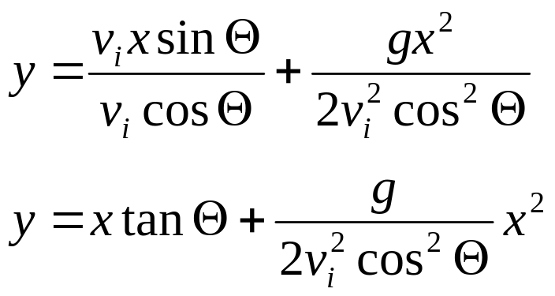
Trajectory
x = v_{i} t cos Θ
y = v_{i} t sin Θ + ½ g t²
Parabola, open down
y
Eliminate time, t
t = x/(v_{i} cos Θ)
y = bx + ax²
x

Slide 25
Total Time, Δt
y = v_{i} t sin Θ + ½ g t²
final height y = 0, after time interval Δt
0 = v_{i} Δt sin Θ + ½ g (Δt)²
Solve for Δt:
0 = v_{i} sin Θ + ½ g Δt
Δt =
x
2 v_{i} sin Θ
t = 0 Δt
(-g)

Slide 26
Horizontal Range, Δx
x = v_{i} t cos Θ
y
final y = 0, time is the total time Δt
Δx = v_{i} Δt cos Θ
2 v_{i} sin Θ
Δt =
x
(-g)
0
sin (2 Θ) = 2 sin Θ cos Θ
Δx
2v_{i} ² sin Θ cos Θ
v_{i} ² sin (2 Θ)
Δx =
Δx =
(-g)
(-g)

Slide 27
Horizontal Range, Δx
v_{i} ² sin (2 Θ)
Δx =
(-g)
Θ (deg) | sin (2 Θ)
0 | 0.00
15 | 0.50
30 | 0.87
45 | 1.00
60 | 0.87
75 | 0.50
90 | 0
CONCLUSIONS:
Horizontal range is greatest for the throw angle of 45⁰
Horizontal ranges are the same for angles Θ and (90⁰ – Θ)

Slide 28
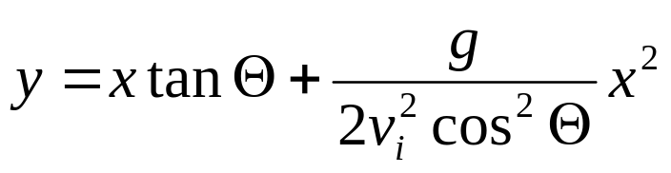
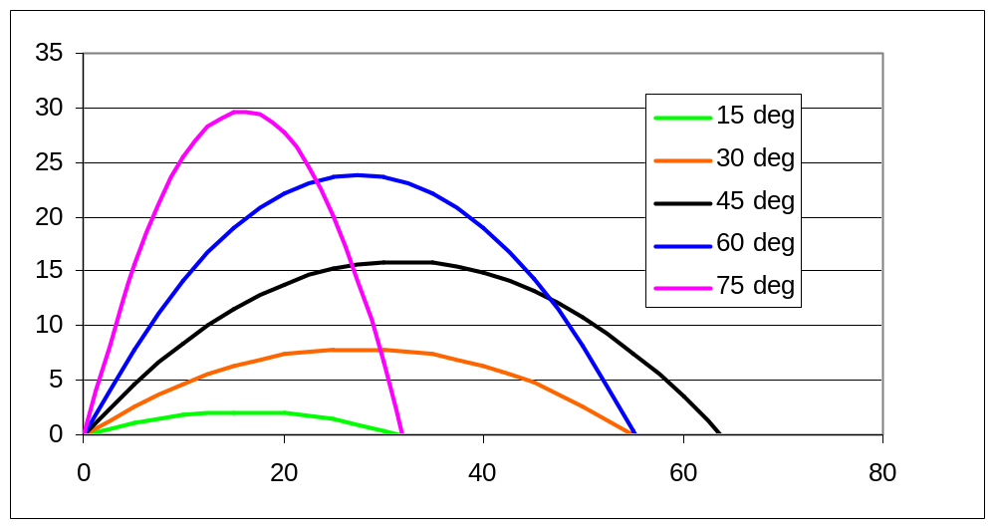
Trajectory and horizontal range
v_{i} = 25 m/s

Slide 29
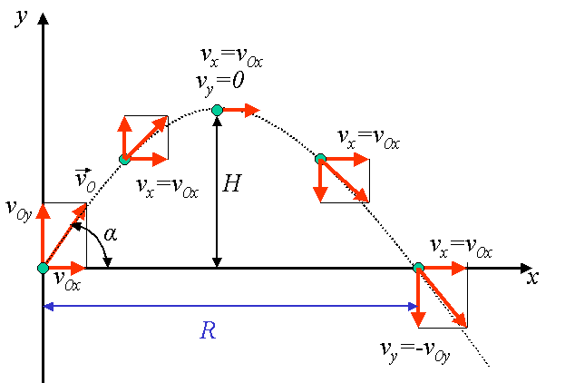
Velocity
Final speed = initial speed (conservation of energy)
Impact angle = - launch angle (symmetry of parabola)

Slide 30
Maximum Height
v_{y} = v_{i} sin Θ + g t
y = v_{i} t sin Θ + ½ g t²
At maximum height v_{y} = 0
0 = v_{i} sin Θ + g t_{up}
h_{max} = v_{i} t _{up}sin Θ + ½ g t_{up}²
h_{max} = v_{i}² sin² Θ/(-g) + ½ g(v_{i}² sin² Θ)/g²
h_{max} =
v_{i} sin Θ
t_{up} =
v_{i}² sin² Θ
(-g)
2(-g)
t_{up} = Δt/2

Slide 31
Projectile Motion – Final Equations
(0,0) – initial position, v_{i} = v_{i} [Θ]– initial velocity, g = -9.81m/s²
Trajectory | Parabola, open down
Total time | Δt =
Horizontal range | Δx =
Max height | h_{max} =
2 v_{i} sin Θ
(-g)
v_{i} ² sin (2 Θ)
(-g)
v_{i}² sin² Θ
2(-g)

Slide 32

PROJECTILE MOTION - SUMMARY
Projectile motion is motion with a constant horizontal velocity combined with a constant vertical acceleration
The projectile moves along a parabola

